Slide 1
… having as its aim the creation of a climate of understanding and mutual respect for the dignity and worth of each person so that each person feels a part of the community and able to contribute fully to the development and well-being of the community …
Preamble - Ontario Human Rights Code
Notes:
Welcome! The OCDSB is developing a human rights policy to promote and protect the human rights of students, staff and families in the OCDSB community. We’re talking about your human rights.
As part of this process, we want to hear from you! We want to build a policy that reflects your priorities and that creates a way for you to raise human rights concerns and have them addressed. We want you to feel safe using the process and we want it to be accessible for everyone in the richly diverse OCDSB community.
The human rights policy will outline rights and responsibilities and create a process for students and their families, staff and community members to raise concerns. It will not only promote and protect human rights, but it will also be an accountability mechanism for the OCDSB itself.
This short presentation, provides you with some insight into how you can get involved and share your opinion. What we learn and hear in these forums will help shape the human rights policy for our District.

Slide 2
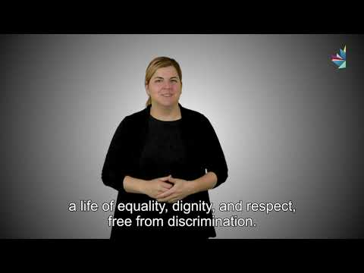
What are human rights?
From: Canadian Human Rights Commission
https://www.chrc-ccdp.gc.ca/eng/content/asl
Notes:
What are human rights? Human rights define what we are all entitled to as human beings: a life of equality, dignity and respect, free from discrimination. Everyone in the world is entitled to the same basic human rights. You are born with human rights. You do not have to earn them. We have the right to enjoy our human rights without discrimination because of our ancestry, race, colour, ethnicity, citizenship, ability, age, religion, gender, or who we love. We have the right to work and learn in a place that is free from discrimination.

Slide 3
What is the right to education?
Equal opportunity
Fullest potential
Non-discrimination
Diversity and human rights
Notes:
The right to education is a fundamental human right. An education unlocks a person’s ability to access their other rights. Every child has the right to an education that provides equal opportunity, that educates them to their fullest potential, where they don’t experience discrimination and where they are taught about diverse cultures and human rights. This right includes the right to learn truth about Indigenous histories, cultures, traditions and perspectives.

Slide 4
What is discrimination?
Unfair or negative treatment
Because of race, gender, religion, disability or any other protected ground
Discrimination
Notes:
What is discrimination? Discrimination is an action or decision that treats a person or a group unfairly or negatively for reasons such as their race, gender, religion, disability, age or other particular reasons. The Ontario Human Rights Code protects people from discrimination for 17 reasons. These reasons are called grounds for discrimination. The grounds protected from discrimination in Ontario include race, ancestry, colour, citizenship, ethnic origin, place of origin, religion, sex, sexual orientation, gender identity, gender expression, disability, age, and family or marital status.

Slide 5
What is harassment?
Unwelcome verbal, psychological, physical or environmental behaviour that continues over time
Because of race, gender, religion, disability or any other protected ground
Harassment
Notes:
What is harassment? Harassment is a form of discrimination. It includes any unwelcome verbal, physical, psychological or environmental behaviour that offends or humiliates you. Generally, harassment is a behaviour that continues over time. In some cases, serious one-time incidents can also be considered harassment. Harassment occurs when someone makes unwelcome remarks or jokes about your race, religion, disability or any other ground of discrimination; when they threaten or intimidate you because of your sex, age, family status or any other protected ground; when they make unwanted physical contact with you, such as touching, patting, pinching or hugging; or when they ostracize or isolate you because of your gender identity, colour or any other protected ground; when they subject you to written graffiti or pictures or images because of a ground protected from discrimination. All of these are examples of harassment.

Slide 6
What is accommodation?
Sometimes barriers exist that prevent a person from equally enjoying their rights.
‘Accommodations’ are changes that we make to allow a person to fully access their rights.until such time as the systemic barriers are removed.
Notes:
What is accommodation? Sometimes barriers exist that prevent a person from fully enjoying their rights. ‘Accommodations’ are changes that we make to remove these barriers and allow you or your child to fully access your rights.

Slide 7
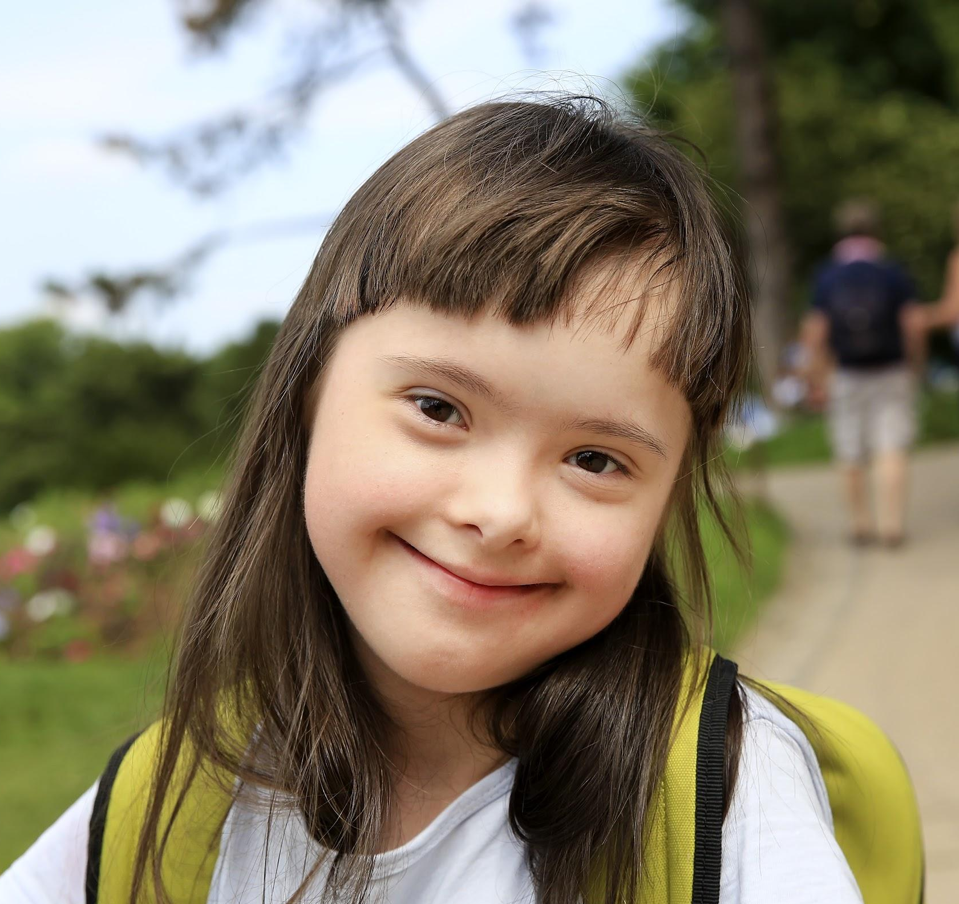
Consultation Questions
Q4. How can the OCDSB best communicate with staff, students and families to help them understand their rights and responsibilities and to understand how to raise a human rights concern if they have one?
Q3 When someone has a human rights concern, there are many ways it can be addressed. How do you think the OCDSB can receive and respond to a human rights concern in a way that makes that person feel safe? How can we improve the process to make it more accessible and effective for everyone?
Q2 Grounds protected from discrimination under the Ontario Human Rights Code include race, ancestry, place of origin, colour, ethnic origin, citizenship, creed, sex, sexual orientation, gender identity, gender expression, age, marital status, family status and disability. Are other factors that you think should be considered? Why?
Q1 What do you think are the most important human rights issues for the OCDSB to address? Why?
Notes:
We’ve developed a number of questions to help guide your inputs into the development of the human rights policies and to centre our discussions in community forums and focus groups.
Q1 - Prompts to get you thinking: Are there any identities that you think experience discrimination within OCDSB? In what ways are they experiencing discrimination? How can the OCDSB prevent this discirmination from happening?
Q2- Prompts to get you thinking: What are some of the other reasons people may experience discrimination? Should these reasons be protected from discrimination by the new OCDSB human rights policy? Why or why not? For example, what about socioeconomic status? Language? Other reasons?
Q3 - Prompts to get you thinking: How can we build trust in the process? How can we help people feel safe? What kind of process would work for students, staff or families? How can we make it accessible for Indigenous peoples, or people with disabilities, for people who don’t speak English or French? Other people? What kind of supports should we consider providing?
Q4 - Prompts to get you thinking: What is the best way to help students, families and staff understand their rights and responsibilities under the new policy when it comes out? What type of educational materials should we prepare? What types of engagement and outreach would be most effective in sharing information about the policy?

Slide 8
How can people engage?
Survey
complete and share online survey for parents, students and employees Watch the OCDSB Human Rights Policy Consultation page for more details.
Written Feedback
Submit written feedback to: consultation.humanrights@ocdsb.ca
Community Forums
Participate in upcoming community forums. Watch the OCDSB Human Rights Policy Consultation page for more details.
Focus Group Discussions
Participate in thematic focus group discussions . Watch the OCDSB Human Rights Policy Consultation page for more details.
Notes:
Students, staff, families and community members can engage with the consultation process in a number of ways. Choose one or all of them! We want to hear from you.
Consider completing the anonymous on-line survey. You can find it on the OCDSB Human Rights Policy Consultation Page.
Consider emailing written feedback about something you think is important to: consultation.humanrights @ocdsb.ca.
Think about signing up to participate in a community forum or a focus group discussion. Watch the OCDSB Human Rights Policy Consultation Page for details about the opportunities as they become availalbe.
Promoting and protecting human rights is all of our responsibility. Get involved and help us build a policy that centres dignity and respect for everyone in our community. Human rights are for everyone.

Slide 9
Timeline
We are here
↓
Sept. 2020
Dec. 2020
Mar. 2021
Apr. 2021
Jun. 2021
Oct. 2021
Desk Review
Pre-Consultation
Phase 1 Consultation
Draft Policy
Phase 2 Consultation
Policy Approval
Review OCDSB policies, procedures and provincial, federal and international framework
Discussion with internal working group, DEC, Advisory Committees and student trustees
Meeting with students, staff, parents and community to identify gaps, priorities, accessibility and outreach needs
Use feedback from Phase 1 to draft policy
Revisit students, staff, parents and community to get feedback on draft policy
Revise draft policy based on feedback received and present to Board for approval
Notes:
This is the timeline for the human rights policy consultation. We are currently in Phase 1. We will be holding on-line focus group discussions for students, staff and families as well as community forums to create a space for you to share your perspective. We will draft a policy based on what we hear from the OCDSB community in Phase 1, and in Phase 2 we will share the draft policy with everyone again to get additional feedback. We hope to have the human rights policy ready for presentation to the Board of Trustees in October 2021.

